Slide 1

Presentation title
Julian(Xibei) He

Slide 2


Agenda
Industry Profile
Approach process
Key Questions
Recommendations
Looking forward

Slide 3


INDUSTRY Profile
Film making budget increases 60% in last 20 years
P&A costs increase 44% from 2014 to 2019 alone
60%-80% of films lose money

Slide 4
Approach: CRISP-DM
3rd party Data
IMDB database
Box office
Movie Budgets
Profit Measures
NOI
Correlations

Slide 5



Does spending more money make movie profitable?

Slide 6
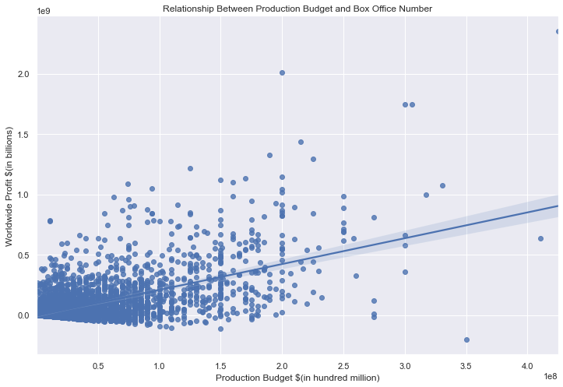
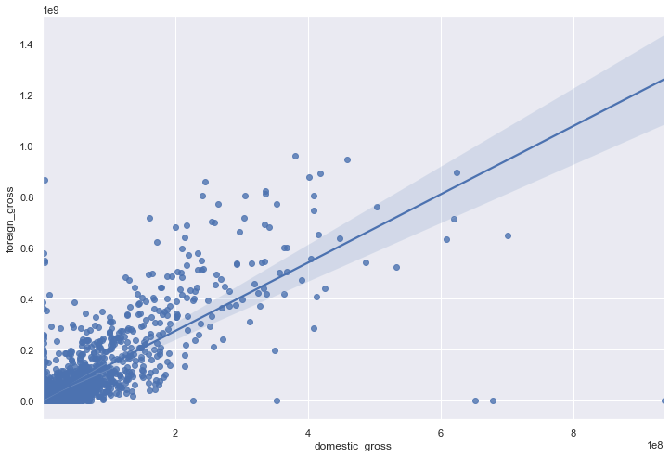
Quantitative measures

Slide 7

What factors contribute to the popularity of a movie

Slide 8
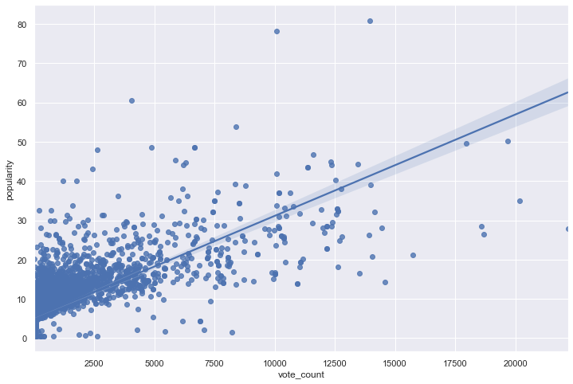
The more online exposure a movie get, its popularity is likely to increase
Somewhat explains why P&A expenses makes up about 50% of movie production budget

Slide 9

How genres related to the success of a movie

Slide 10
The more online exposure a movie get, its popularity is likely to increase
Somewhat explains why P&A expenses makes up about 50% of movie production budget

Slide 11
Recommendations

Slide 12
Higher production budget
Optimize marketing strategy
Make movie across multiple genres

Slide 13




Looking forward – Macro factors
Social media esposure
Industry growth(online streaming platform)
Social aspects

Slide 14

Thank you
Julian(Xibei) He
Julianhe1991@gmail.com
github

